Slide 1
INTRAOPERATIVE ULTRASOUND IN NEUROSURGERY

Slide 2
MYTHS
Image Quality: ?inferior to MR
Minimally invasive surgery incompatible: ?need for bigger craniotomies
No use at end of surgery?, decline in image quality
US interpretation ?difficult than MR

Slide 3
History
French et al. – 1950
(A Mode – experimental studies on brain tumor)
Leksell- 1954 , SDH localization, later Echoencephalogram
Wild and Reid – 1978

Slide 4
Physical Principles
Reflection- most important for image buildup
Absorption
Scattering
Artifacts

Slide 5
Image Buildup
Frequency :
High frequency(10MHz)- high resolution, less penetration and vice versa
Focus : Beam – narrowing- higher resolution
Depth : Deeper gives more overview.
AIM – to achieve resolution 25 um at 50 MHz
Notes:
Surfcae lesion < 15 mm cortex 10Mhz, Focus 20 mm, depth 40 mm max….
Deep lesion 5 Mhz, Focus 50 mm, depth 70 mm

Slide 6
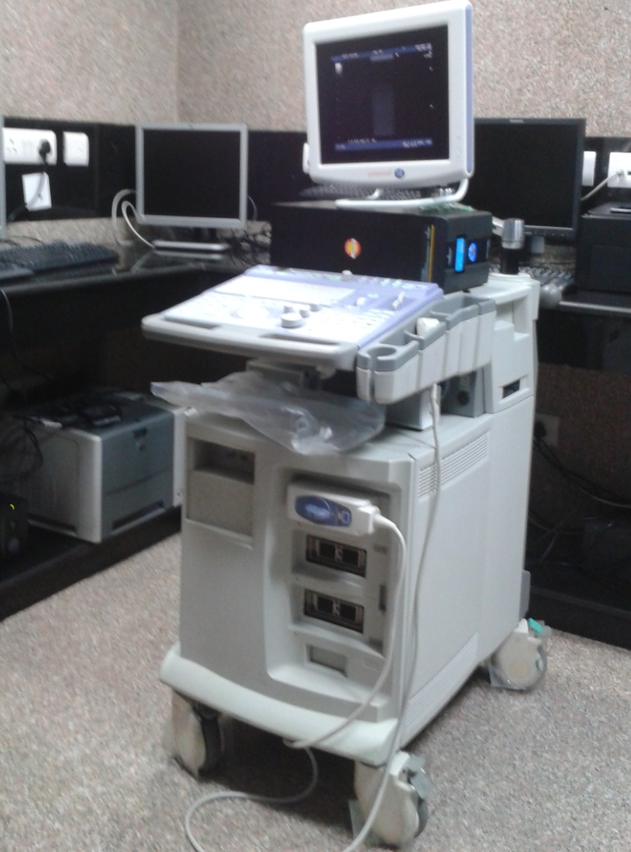
Machine considerations
Modes *ABCD
Storing features
Transducers *
Financial considerations

Slide 7
Modes
A Mode- amplitude mode, depth measurement
Uses:
Seldom used
Focused beam for calculi Rx
B Mode- Brightness mode(real time gray scale display >18fps)
Uses:
Real time imaging
Widely used

Slide 8
Modes
C Mode– Color mode
- All moving particles encoded with different red and blue shades
- Velocity and direction dependent
Uses: Blood flow/vessels detection
D Mode- Doppler/power/ angio mode
- amplitude of moving structures
Uses : small/slow flow vessels display

Slide 9
Terminology
1. Echogenicity
Depends on – Reflections of tissue
Anechogenicity : No echogenicity(ventricle)
Low Echogenicity: Normal white matter
High Echogenicity: Glioma
Hyperechogenicity: calcifications/bone- meningiomas

Slide 10
Terminology
2. Homogeneity
Homogenous- low grade gliomas
Inhomogeneous - high grade glioma
3. Demarcation
Infiltrative v/s Non infiltrative tumors and extent of resection.
Notes:
Inhomogenous- with different echoic parts- high grade gliomas

Slide 11
Artifacts
BLURRED IMAGE
Source: Bubbles trapped at contact surfaces
Brain- sheath
sheath- probe interface
REVERBERATIONS
Source: brain spatulas,
SHADOWING
Source: calcifications
Increased ECHOGENICITY
Source: cysts in front of structures

Slide 12
Transducers
Linear array and Convex array- Not useful
(convex interface and poor resolution)
Phased array- widely used
BEST- small phased rectangular acoustic lens and area of contact 20-25 mm

Slide 13
Transducers- suited in NSx
Phased array
Burrhole transducer
Convex array

Slide 14
Sterilization
Not suited
Sterile sheath to be used

Slide 15
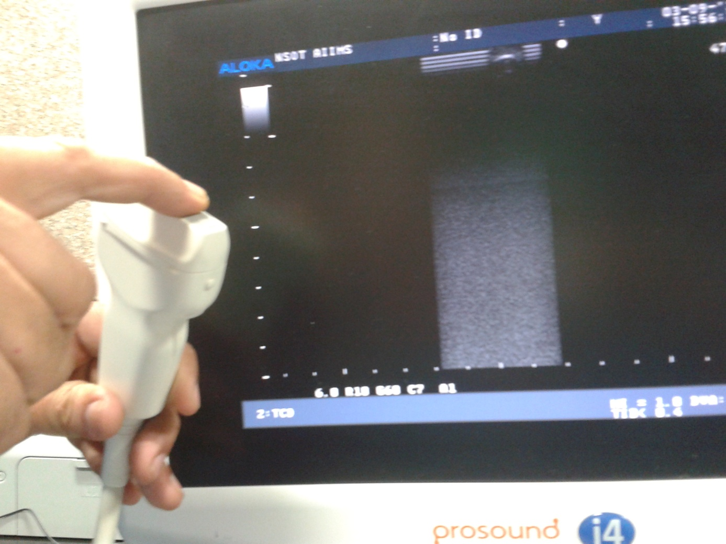
Getting started
First locate sulci/interhemispheric fissure to gain orientation

Slide 16
Applications
Mass Lesions localization
Inflammatory and Infectious disorders
AVM
Burrhole /guided biopsies
VP shunt
Aneurysm
Neuronavigation

Slide 17
MASS LESION LOCALISATION- cranial
All tumors Hyper echoic,
except- cystic components and Lymphoma(iso to hypo echoic)
Surrounding parenchyma and vasogenic edema – relatively hypoehoic
PITFALLS- Chronic edema /radiation changes may change echogenicity. Wrong orientation over gyrus

Slide 18
Cranial Uses
Resection control
To delineate tumor vascularity
Localizing site for biospy
Minimally invasive hematoma drainage
Aspiration of abscess and cysts
Patency of arterial bypasses

Slide 19
MASS LESION LOCALISATION- cranial
Vascularity assessment- Colour duplex sonography – B mode with color mode
High grade glioma, in relation to vessels

Slide 20
Resection control
Thalamic tumor in sagittal and coronal planes, with gradual excision. At end of resection residual seen And was resected further to achieve sonograhic total excision

Slide 21
MASS LESION LOCALISATION- Spinal
Normal spine
Dura: Echogenic ring with surrounding anechoic CSF
Spinal cord: homogeneous low-level echoes, demarcated from CSF by bright echogenic line
Central canal: echogenic structure
Nerve roots: echogenic

Slide 22
MASS LESION LOCALISATION- Spinal
Mass Lesions characteristics:
Cyst/syrinx- anechoic
IM tumor- complex cystic and solid
IM neoplasms - inhomogenous hyperechoic
(glioma, metastases)
Calcifications enhance echogenicity
(ependymoma, astrocytoma, dermoid)

Slide 23
MASS LESION LOCALISATION- Spinal
Mass Lesions characteristics:
- Focal cord expansion and obliteration of the
central canal
- Extramedullary lesions are generally hyper-echoic (disk, hematoma, meningioma, neurofibroma, bone , cyst abscess)

Slide 24
Spinal Uses
Syrinx- localize site of needle insertion/ perforation
Tumor biopsy
Myelotomy in avascular planes
Tumor resection

Slide 25
Neuronavigation
3D USG : By tilting the ultrasound probe over the area of interest, a collection of 2D ultrasound images is acquired, forming a 3D ultrasound image volume
Camera indentifies position of the patient reference frame and the US probe and enables display with corresponding preop MR
Time taken ~ 1 min

Slide 26
Neuronavigation
Accuracy of 3D US
Preop MR may not predict intraop brain shifts
Image to patient registration is not needed for navigation based on intra-operative US
Acquisition is performed in the same coordinate system as navigation is executed.
New 3D images can be acquired in order to compensate for brain shift

Slide 27
Other procedures : Biopsy
Free hand
USG transducer mounted biospy probe
Diagnostic yields of 85-100% reported in literature-
Depth and nature of pathology
Most hyperechoic region to be chosen

Slide 28
Other procedures : VP shunt
Special burrhole transducer < 12mm diameter
use of separate burrhole/ larger burrhole, in open fontanelle

Slide 29
Cavernoma
Hyperechogenicity
Inhomogeneous- microcalcification, cysts, thrombosis
Demarcation- may be be sharp (cause- iron ring)
Difficult to identify flow in cavernoma

Slide 30
Venous anomaly
Criteria:
- slow flow (<5 cm/s)
- flow away from lesion
Other cerebrovascular parameters:
Peak systolic flow (AVM >300 cm/s), diastolic flow
Resistance index (<0.6- AVM)

Slide 31
Other procedures : AVM
Intra-operative 2D colour-duplex-sonography for localizing deep-seated AVMs,
Identifying feeders and draining vessels and for re-section control
Colour Doppler : measure the cerebrovascular resistance and differentiate between feeding vessels and en passant vessels.

Slide 32
Other procedures : AVM
Stereoscopic display or a 3D rendering of the vessels may be helpful to understand the tortuous architecture of the feeding vessels
Image quality and details inferior to MR
ROLE- to estimate shifts and correction and vessels of nidus

Slide 33
Other procedures : Aneurysms
2D US for peripheral aneurysms
Flow evaluation in distal vessels pre and post clipping (systolic flow, RI)
PITFALL: Power Doppler of smaller vessels generates smeared image for navigation
ROLE: not clearly defined and needs improvement

Slide 34
Other procedures : decompression
USG to assess need for duraplasty in Chiari I patients after foramen magnum decompression
ROLE: ? Paradigm shift
CSF related complications v/s No duraplasty
Recurrence rates of symptoms twice in moderate and severe cases in bony decompression only patients-
Mcgirt et al. JNS- pediatrics, July(1) 2008

Slide 35
LIMITATIONS
Operator Dependent
Requires knowledge of neuroradiologic abnormalities that are not routinely evaluated by sonography.
Difficulties in distinguishing a tumour from normal tissue and lesion obscuration by chronic edema.
CT stereotaxis and real-time MRI fusion images.

Slide 36
Future
1.5D probe
- thinner image planes at a wider depth range.
- improve the quality of both tissue imaging and
angiography based on power Doppler

Slide 37
Future
Contrast:
- Thin-shelled micro bubbles (size~RBCs) very strong scatterers of ultrasound
- Size 1-4 um, coupled to galactose, albumin (albunex, levenist)
Administered iv
Increase signal to noise ratio

Slide 38
Future
Strain imaging:
- Elasticity of brain tissue.
Tissue motion of arterial pulsations can US strain images of brain tumors
(histologic clue)
Adjunct to B mode
STATUS- under evaluation

Slide 39
Future
HIFU
- Under evaluation for tumor
- MR guided

Slide 40
USG AIIMS
B- K medical, equipped with linear(vascular), burrhole, convex array
Surgeries
Foramen magnum decompression
Intracranial tumor excision
Spinal IM tumor localization
Biopsy

Slide 41
USG – INDIA: PNDT act
The Pre-natal Diagnostic Techniques Regulation and Prevention of Misuse) Act (1994), 1st January, 1996 enacted
Amendment 2003
Restricted use of USG for prenatal diagnosis of sex

Slide 42
THANK YOU

